Slide 1
Shiny And Flex Dashboards
Class 5

Slide 2
Shiny Dashboard

Slide 3
Basic Layout
Dashboards are broken into a single argument made up of three arguments
Header – Window title as well as Menus
Sidebar – Sidebar for navigating Dashboard tabs and can hold global selection inputs
Body – Where the magic happens.

Slide 4
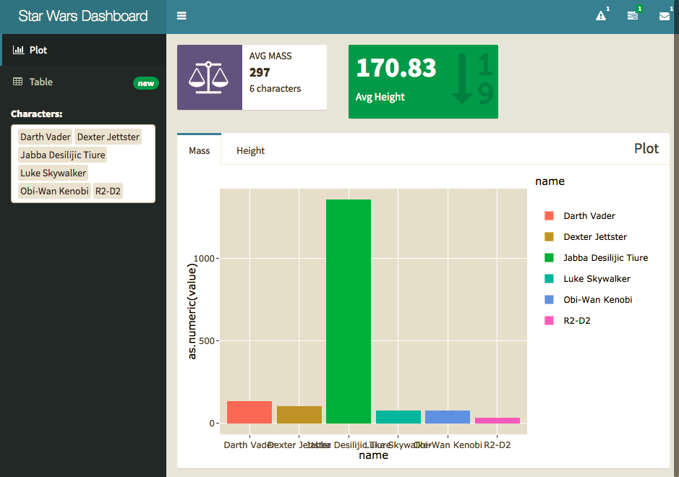

Slide 5
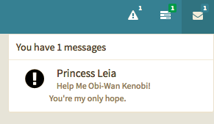
Headers

Slide 6
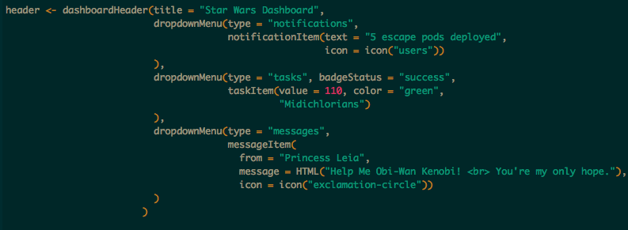

Options
Notifications
Tasks
Messages

Slide 7
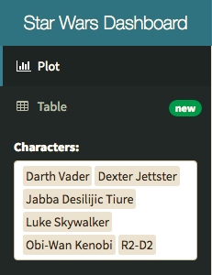
Sidebar

Slide 8
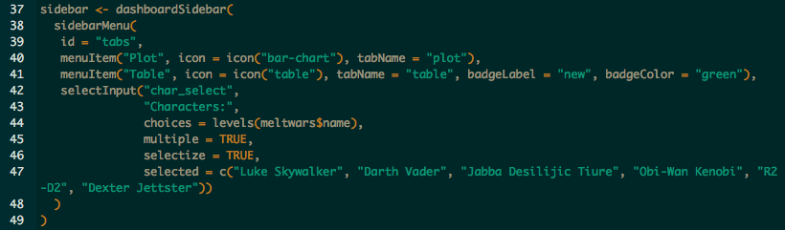
Menu Items – tabName referenced in body.
Global Inputs – Should work on all tabs and for all visuals.

Slide 9
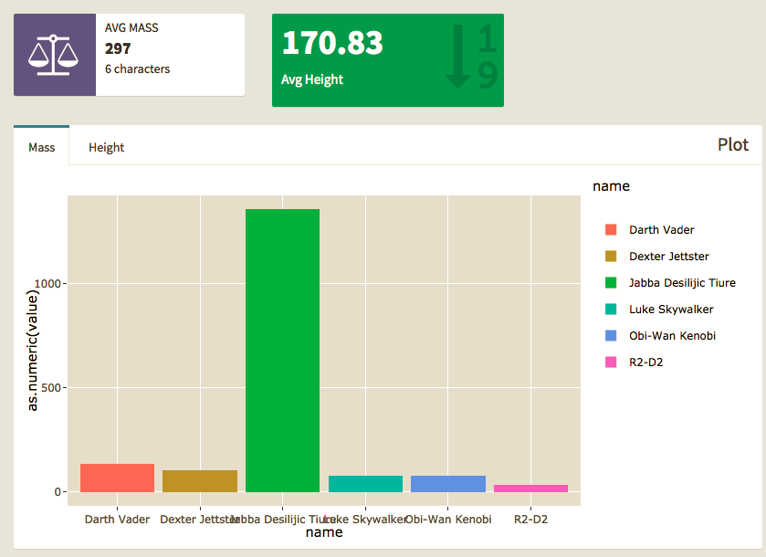
Body

Slide 10
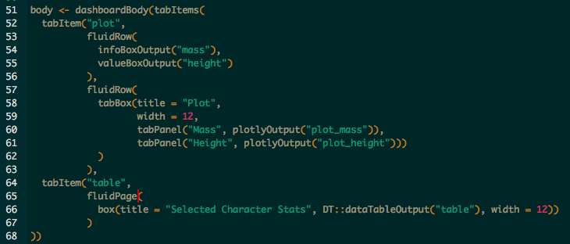
Tab Items – by name in Menu
Row\Page – based layouts
Box – All contents should go in a box
Page is broken into 12 equal bars. Width can be 1-12
If 12+ is specified content will kick to new row automatically, anything unspecified will get squished.
Inputs – can also go in boxes here should be clear what visuals they work with.

Slide 11
Flexdashboard

Slide 12
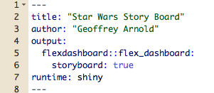
Setup

Slide 13
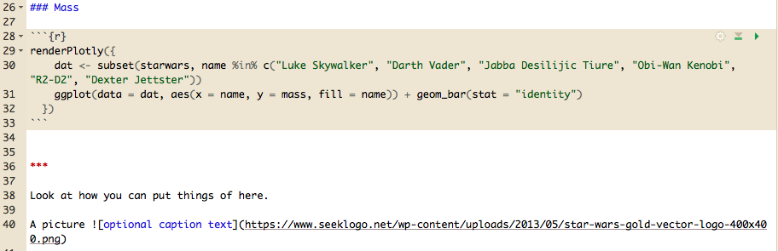
Basic Board Page

Slide 14
Flexdashboard: Storyboard

Slide 15
Setup

Slide 16
Practice
Storyboard - Blank

